Slide 1
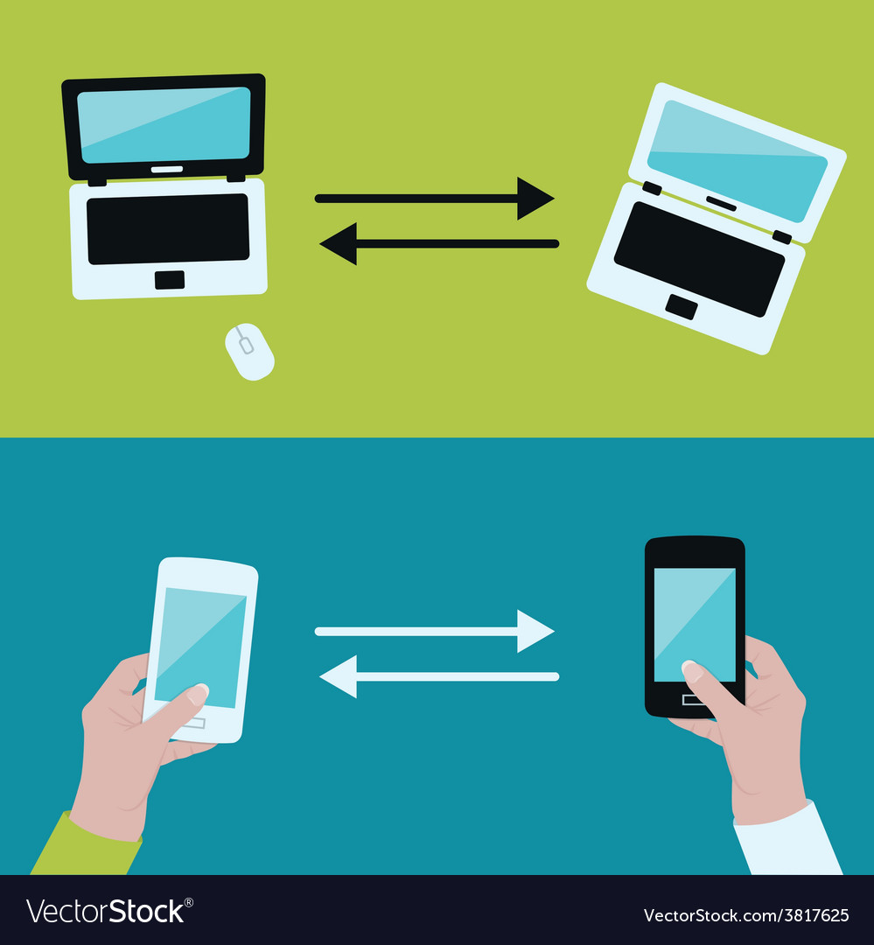
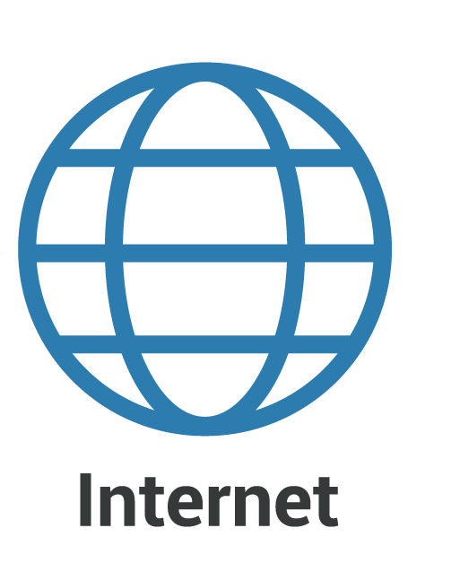
DEVICE DISCOVERY IN D2D COMMUNICATION
PROJECT GUIDE :
Mr. Devarajsamy. S,ME.,
(Assistant professor /IT )
TEAM MEMBERS :
Boopalan G
Giri S
Shathivel Murugan S
Yogesh E

Slide 2
ABSTRACT
Device-to-Device (D2D) correspondence in cell networks is characterized as immediate correspondence between two versatile clients without navigating the Base Station (BS) or center organization.
D2D correspondence is by and large non-straightforward to the cell organization and it can happen on the cell frequencies (i.e., in band) or unlicensed range (i.e., outband).
In a conventional cell organization, all interchanges should go through the BS regardless of whether conveying parties are in range for vicinity based D2D correspondence.
Correspondence voice call and text informing in which clients are only occasionally close enough for direct correspondence.

Slide 3

A Novel Multi-Hop Routing Protocol for D2D Communications in 5G
LITERATURE REVIEW
Rana E. Ahmed has proposed this paper Intelligent transportation frameworks are intended to give imaginative applications and administrations.
To achieve an effective utilization of available resources, reduce latency, improve data rates, and increase system capacity, D2D communication utilizes nearby communicating devices
D2D communications,
5G,
Multi-hop Routing,
Dynamic Source Routing (DSR)

Slide 4
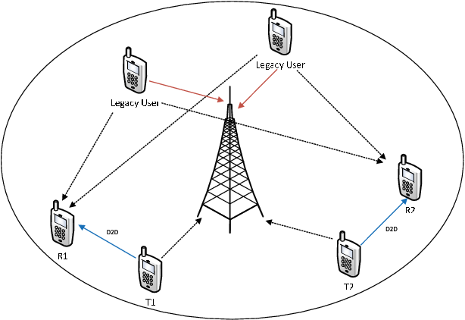
LITERATURE REVIEW Discovery Signal Design and Its Application to Peer-to-Peer Communications in OFDMA Cellular Networks
Michael. Wang, and C. Jiang has proposed this paper Intelligent transportation frameworks are intended to give imaginative applications and administrations.
Proposes a unique discovery signal as an enabler of peer-to-peer (P2P) communication which overlays a cellular network and shares its resources.
Peer-to-peer networks,
neighbor discovery signals,
OFDMA cellular networks

Slide 5
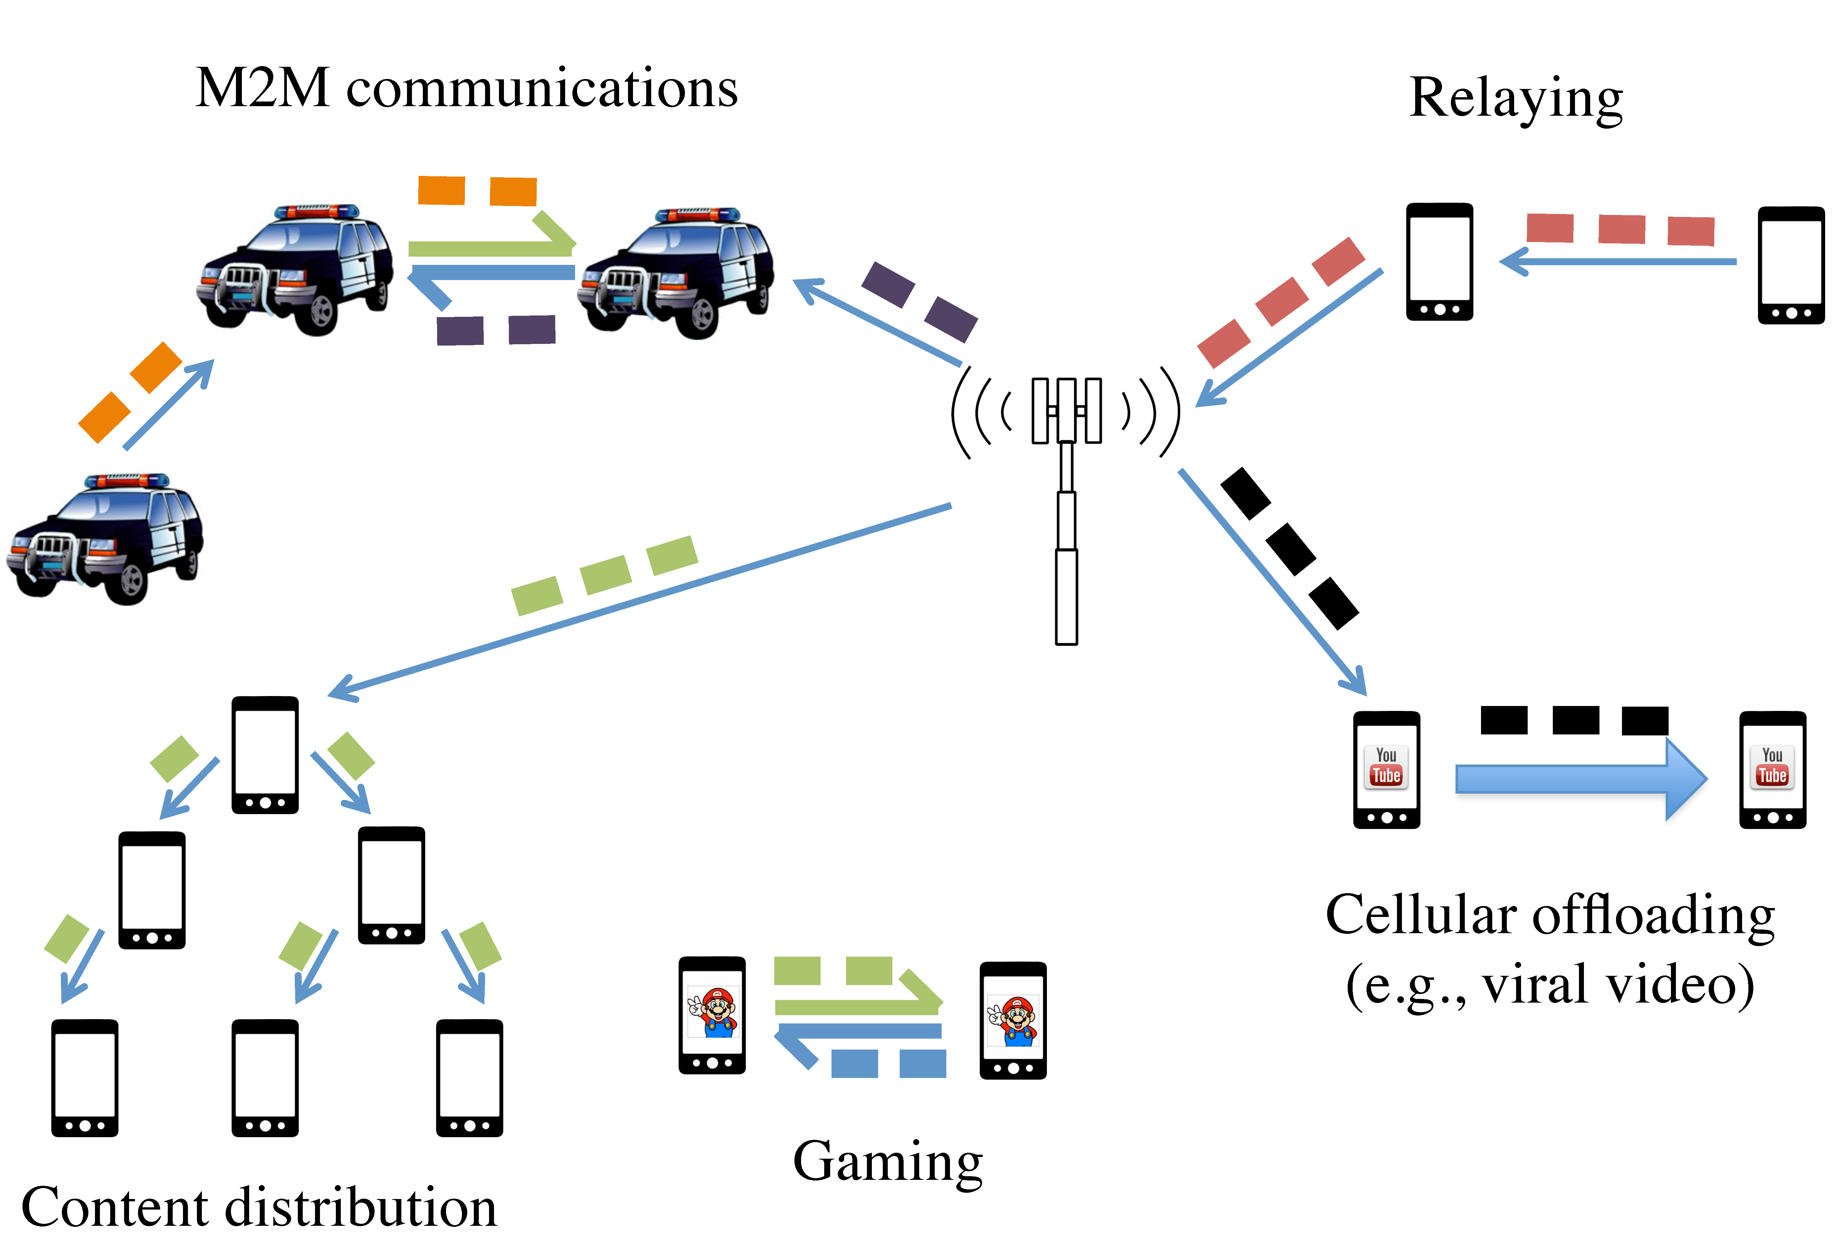
A Survey on Device-to-Device Communication in Cellular Networks
LITERATURE REVIEW
Arash Asadi, Student Member, IEEE, Qing Wang, Student Member, IEEE, and Vincenzo Mancuso, Member, IEEE has proposed this paper Intelligent transportation frameworks are intended to give imaginative applications and administrations
Device-to-Device (D2D) communication was initially proposed in cellular networks as a new paradigm to enhance network performance.
Device-to-Device communication,
Cellular networks,
LTE,
LTE-A

Slide 6

Green Random Access for Wireless Peer Discovery
LITERATURE REVIEW
Taesoo Kwon, Member, IEEE has proposed this paper Intelligent transportation frameworks are intended to give imaginative applications and administrations
This letter investigates the joint design problem of transmission probability (v) and transmit power (p) in random access-based wireless peer discovery (RA-WPD) operations, in terms of reducing the power consumption of the peers.
Peer discovery,
energy saving,
power control,
random access,
stochastic geometry,
D2D networks.

Slide 7
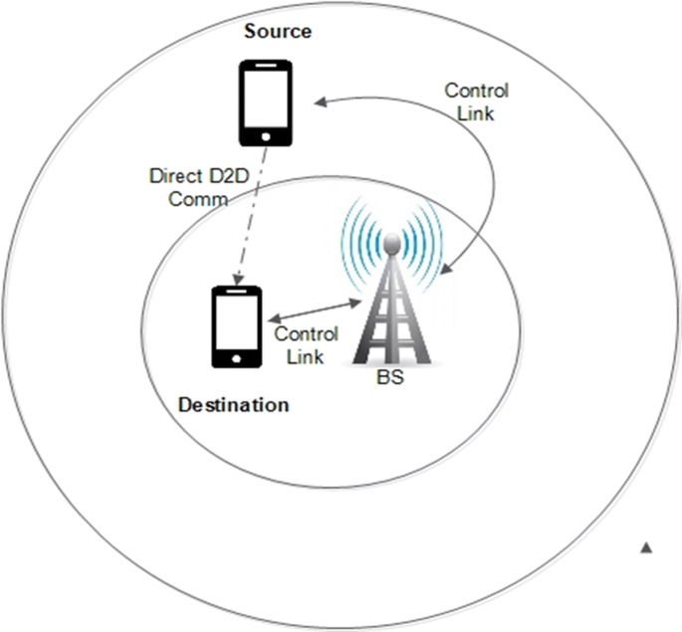
Connectivity of Cognitive Device-to-Device Communications Underlying Cellular Networks
LITERATURE REVIEW
Mohammad G. Khoshkholgh, Yan Zhang, Senior Member, IEEE, Kwang-Cheng Chen, Fellow, IEEE,Kang G. Shin, Life Fellow, IEEE, and Stein Gjessing has proposed this paper Intelligent transportation frameworks are intended to give imaginative applications and administrations
However, such device-to-device (D2D) communications create a new type of interference in cellular systems
Cellular networks,
coverage probability,
interference threshold constraint,
collision probability constraint,
percolation,

Slide 8


ON SERVICE DISCOVERY IN MOBILE SOCIAL NETWORKS: SURVEY AND PERSPECTIVES
LITERATURE REVIEW
Mobile social networks represent a convergence between mobile communications and service-oriented paradigms, which are supported by the large availability and heterogeneity of resources and services offered by recent mobile devices.
In particular, the service-oriented nature of MSN is in the capability of sharing resources and services among devices that lie in proximity and that opportunistically interact.

